Slide 1
Accrue Healthcare Global
2020 - Nitrile Glove Products

Slide 2
Nitrile Gloves
These high quality disposable Nitrile Gloves offer strength, durability and barrier protection that prevents skin contact to ensure contamination does not occur,
They have been designed for maximum sensitivity, dexterity and comfort and offer increased elasticity and flexibility to reduce the risk of fatigue when in use for extended periods of time.
100% Latex Free and Powder Free, also a great alternative for those users sensitive to Latex related proteins.
Approved and Certified by: FDA, CE, ISO, TUV

Slide 3
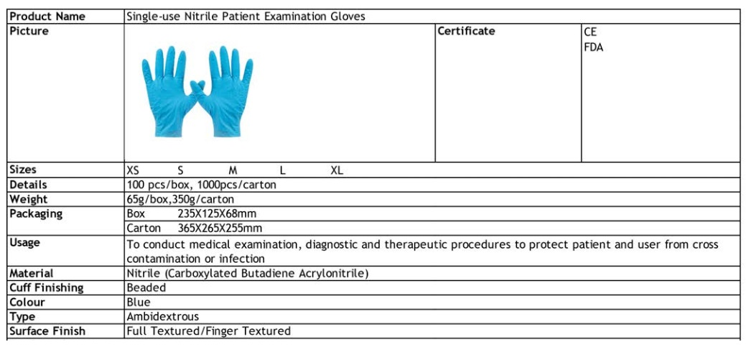
Nitrile Gloves
Specifications:

Slide 4
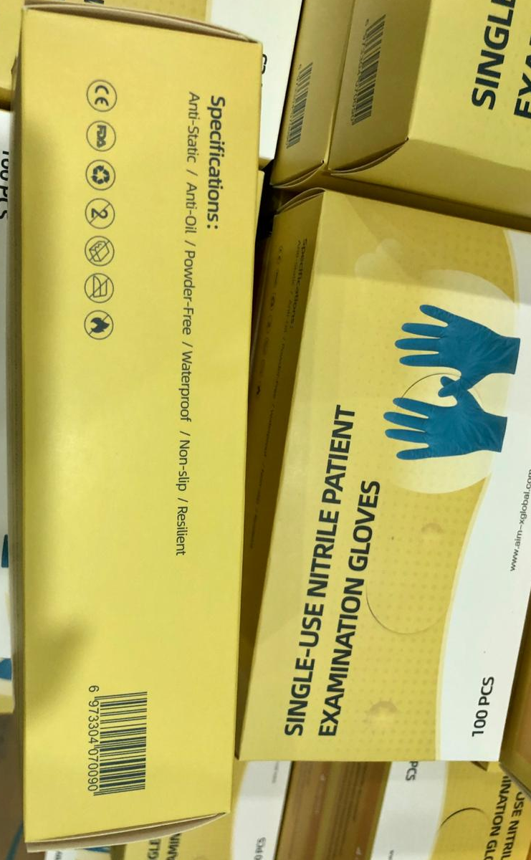
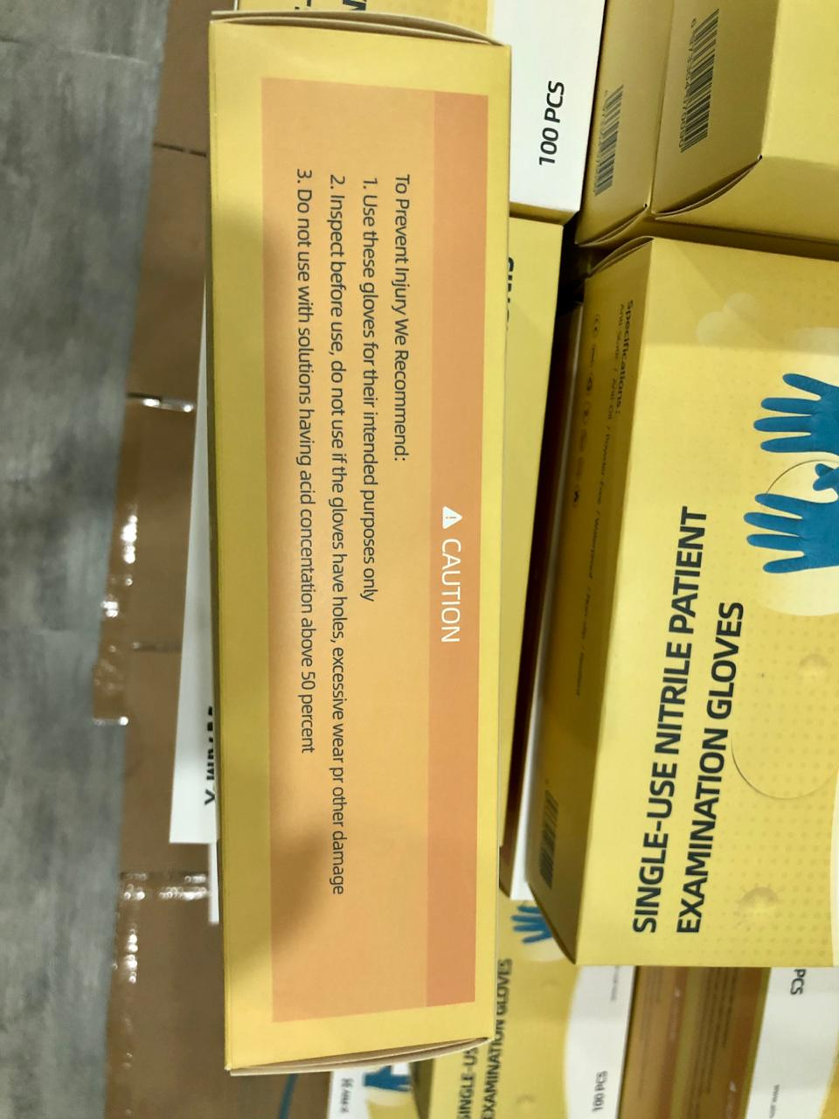
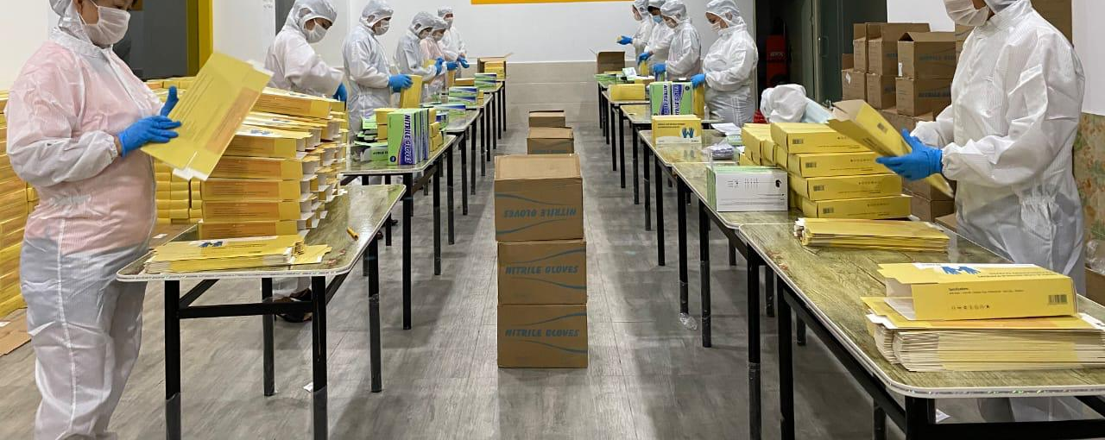
Nitrile Gloves
Packaging

Slide 5
Accrue Healthcare Global

